Slide 1
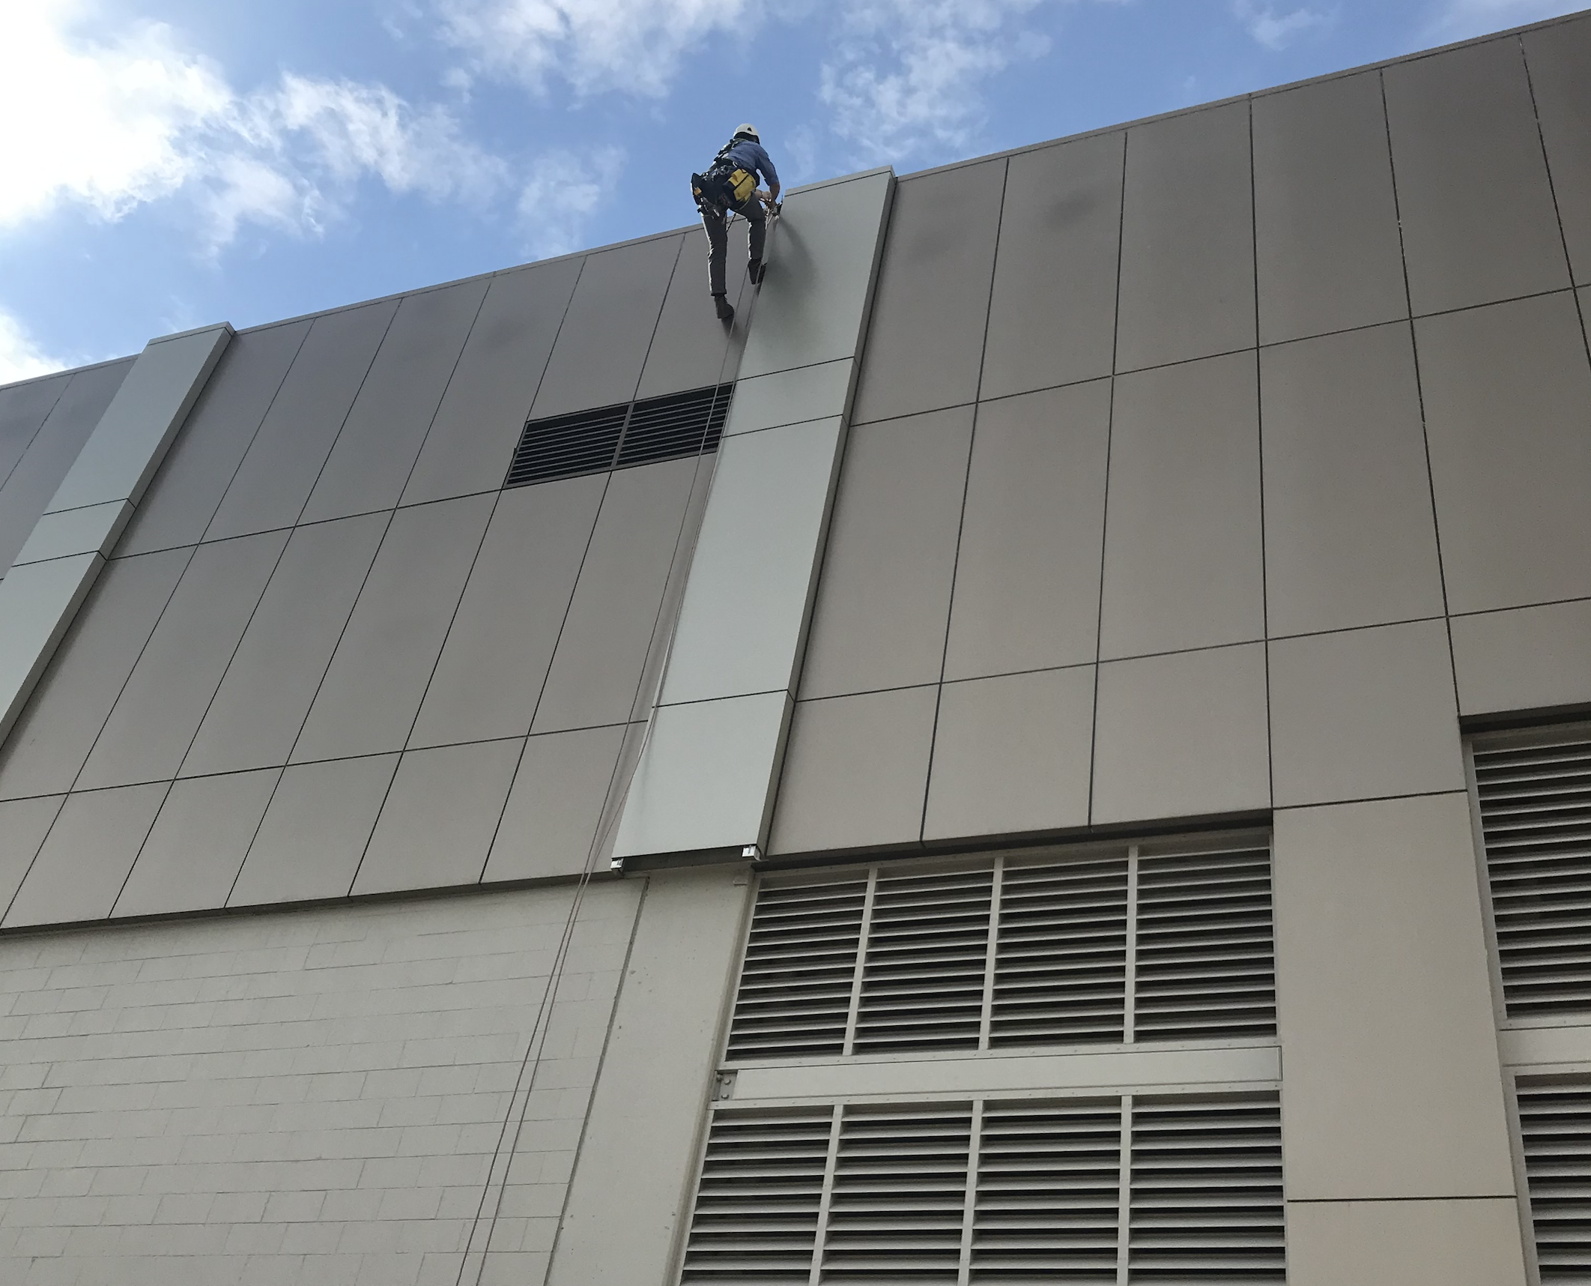
ExcelPlas Cladding Testing
Australia’s Foremost Experts in Cladding Testing

Slide 2
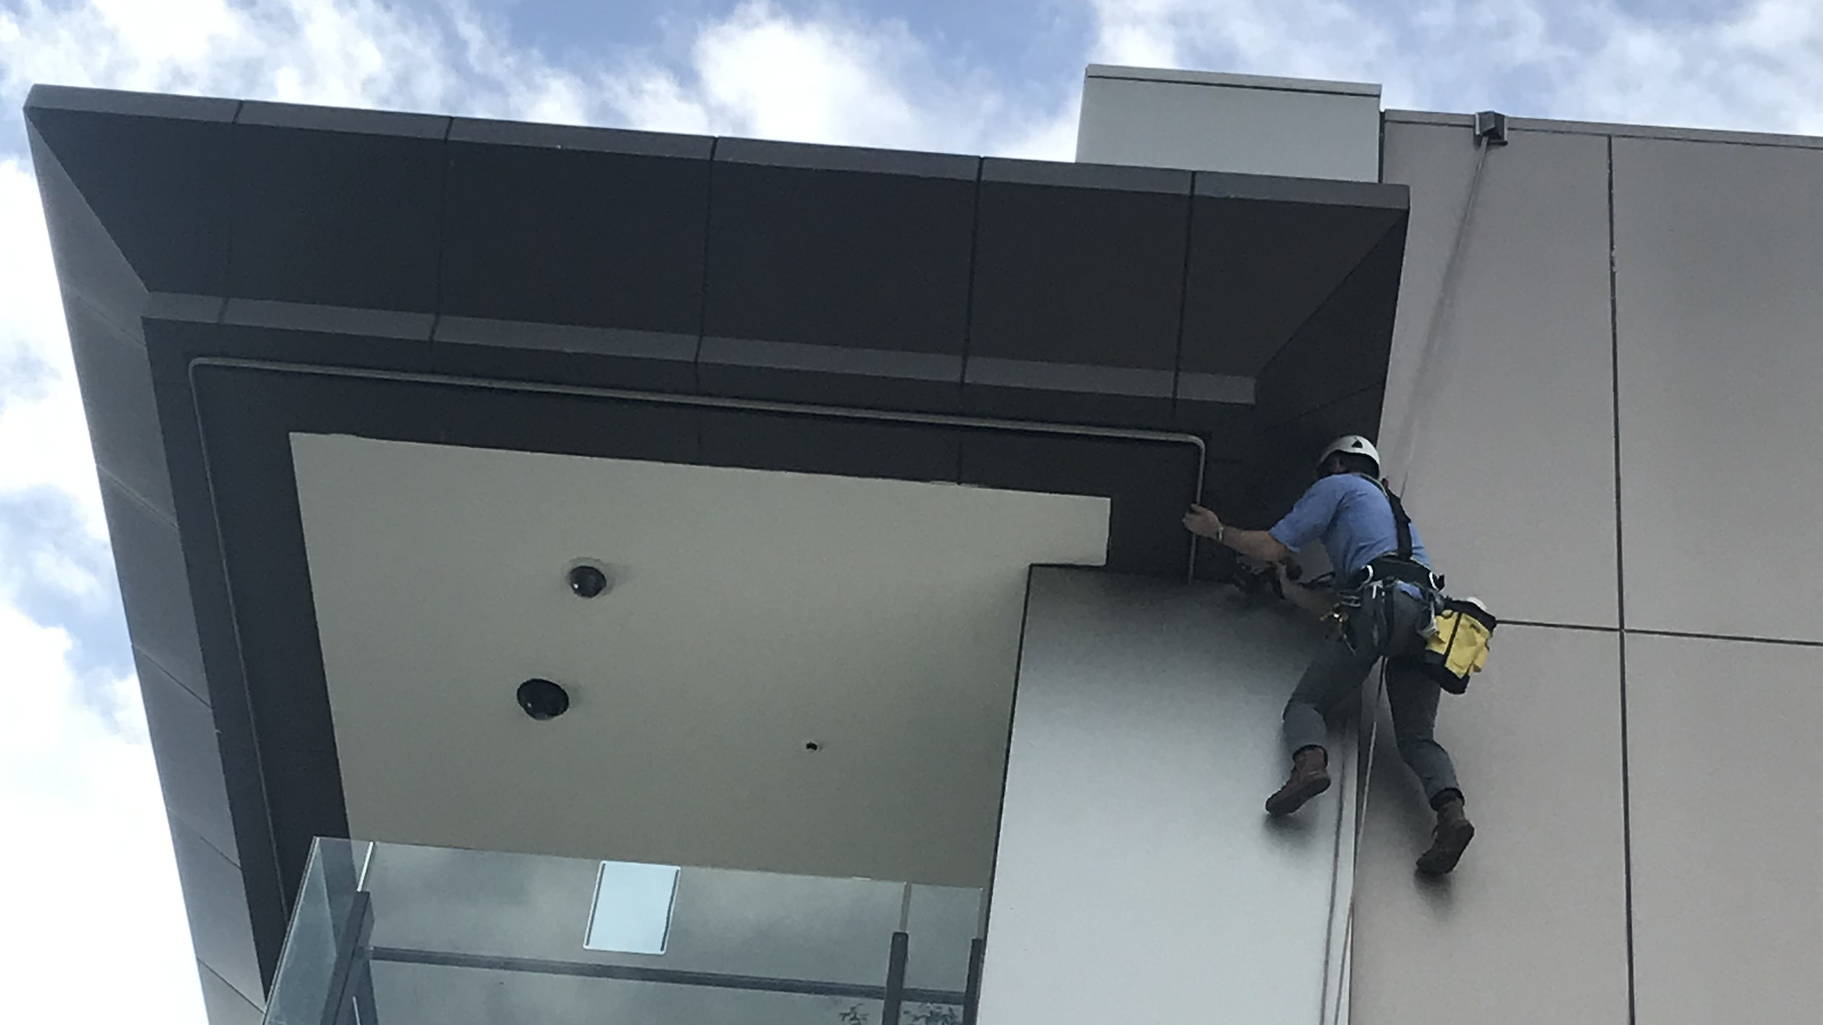
ExcelPlas Cladding Testing
- We deliver results

Slide 4
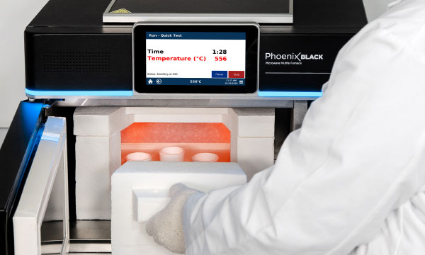
EXCELPLAS is the preferred ACP testing provider for NSW and the Victorian State Government.

Slide 5
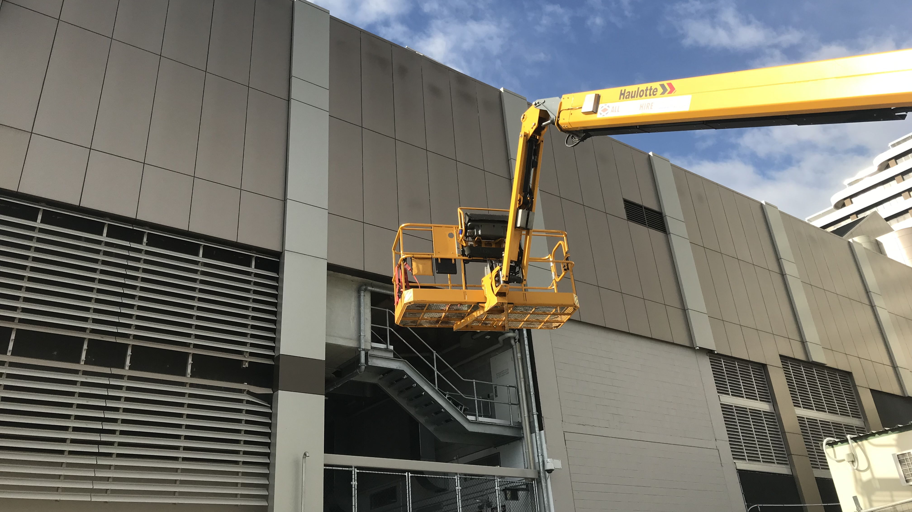
Key outcomes
Determine the building’s façade system composition to assist with understanding risk for Fire Engineers and ICA based ratings.
Risk interpretation data
Full Analytical Report

