Slide 1
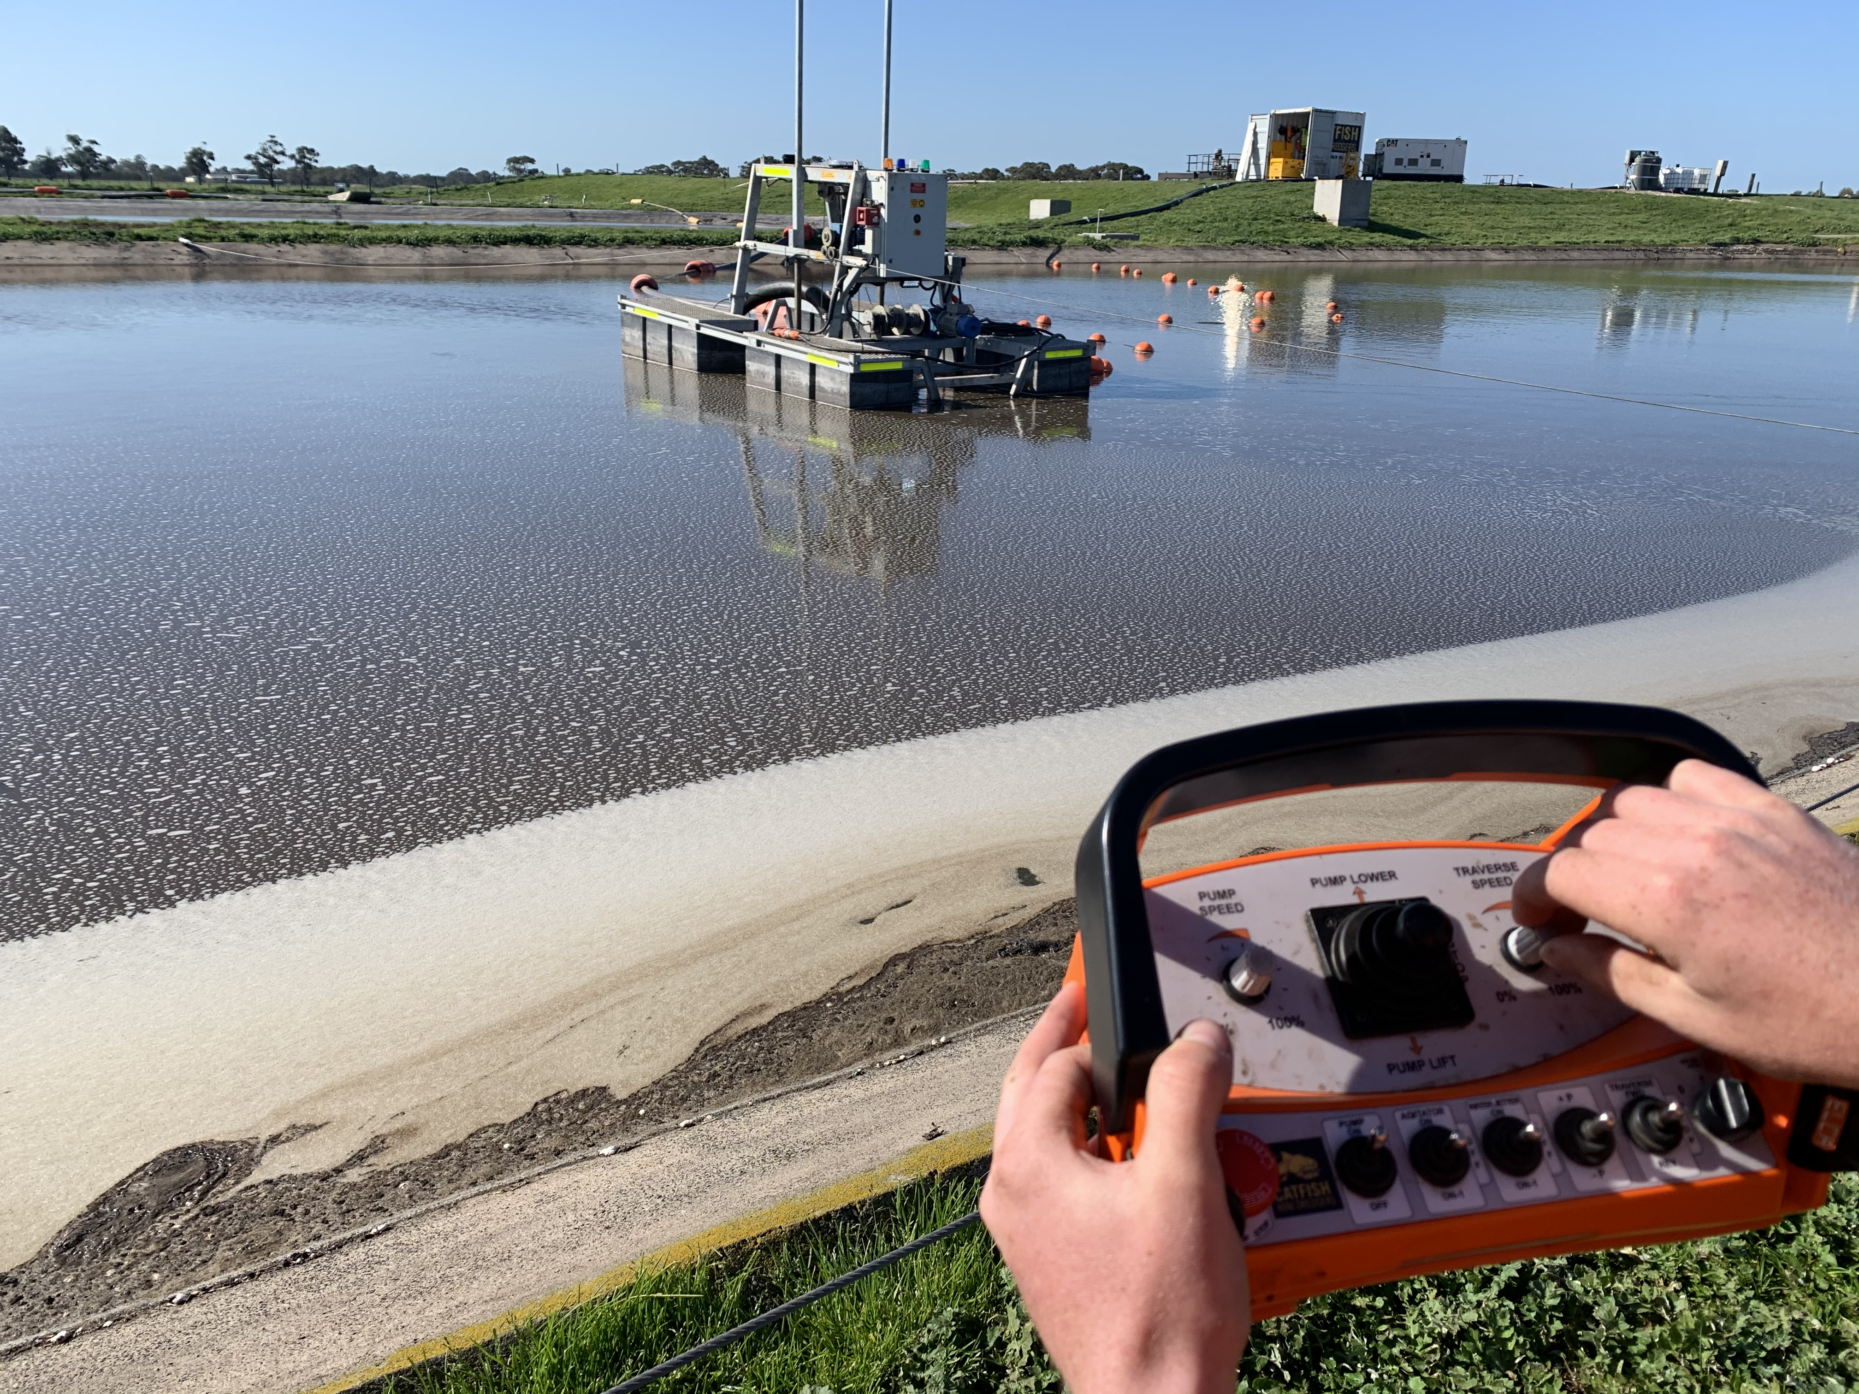
Desludging Wastewater Ponds Made Simple with Remote Controlled Mini-Dredgers

Slide 2
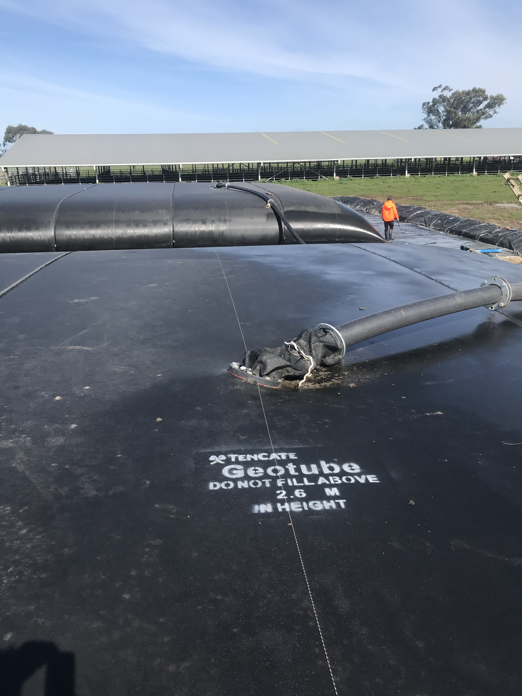
Geotextile Dewatering Bags for Desludging Wastewater Ponds Made Simple

