Slide 1
Women Defining Hempel Coating’s R&D
October 2024
Profile: Helle Fiedler
Lead Scientist R&D,
Hempel A/S
Born: 1963
MSc Chem. Eng.

Slide 2
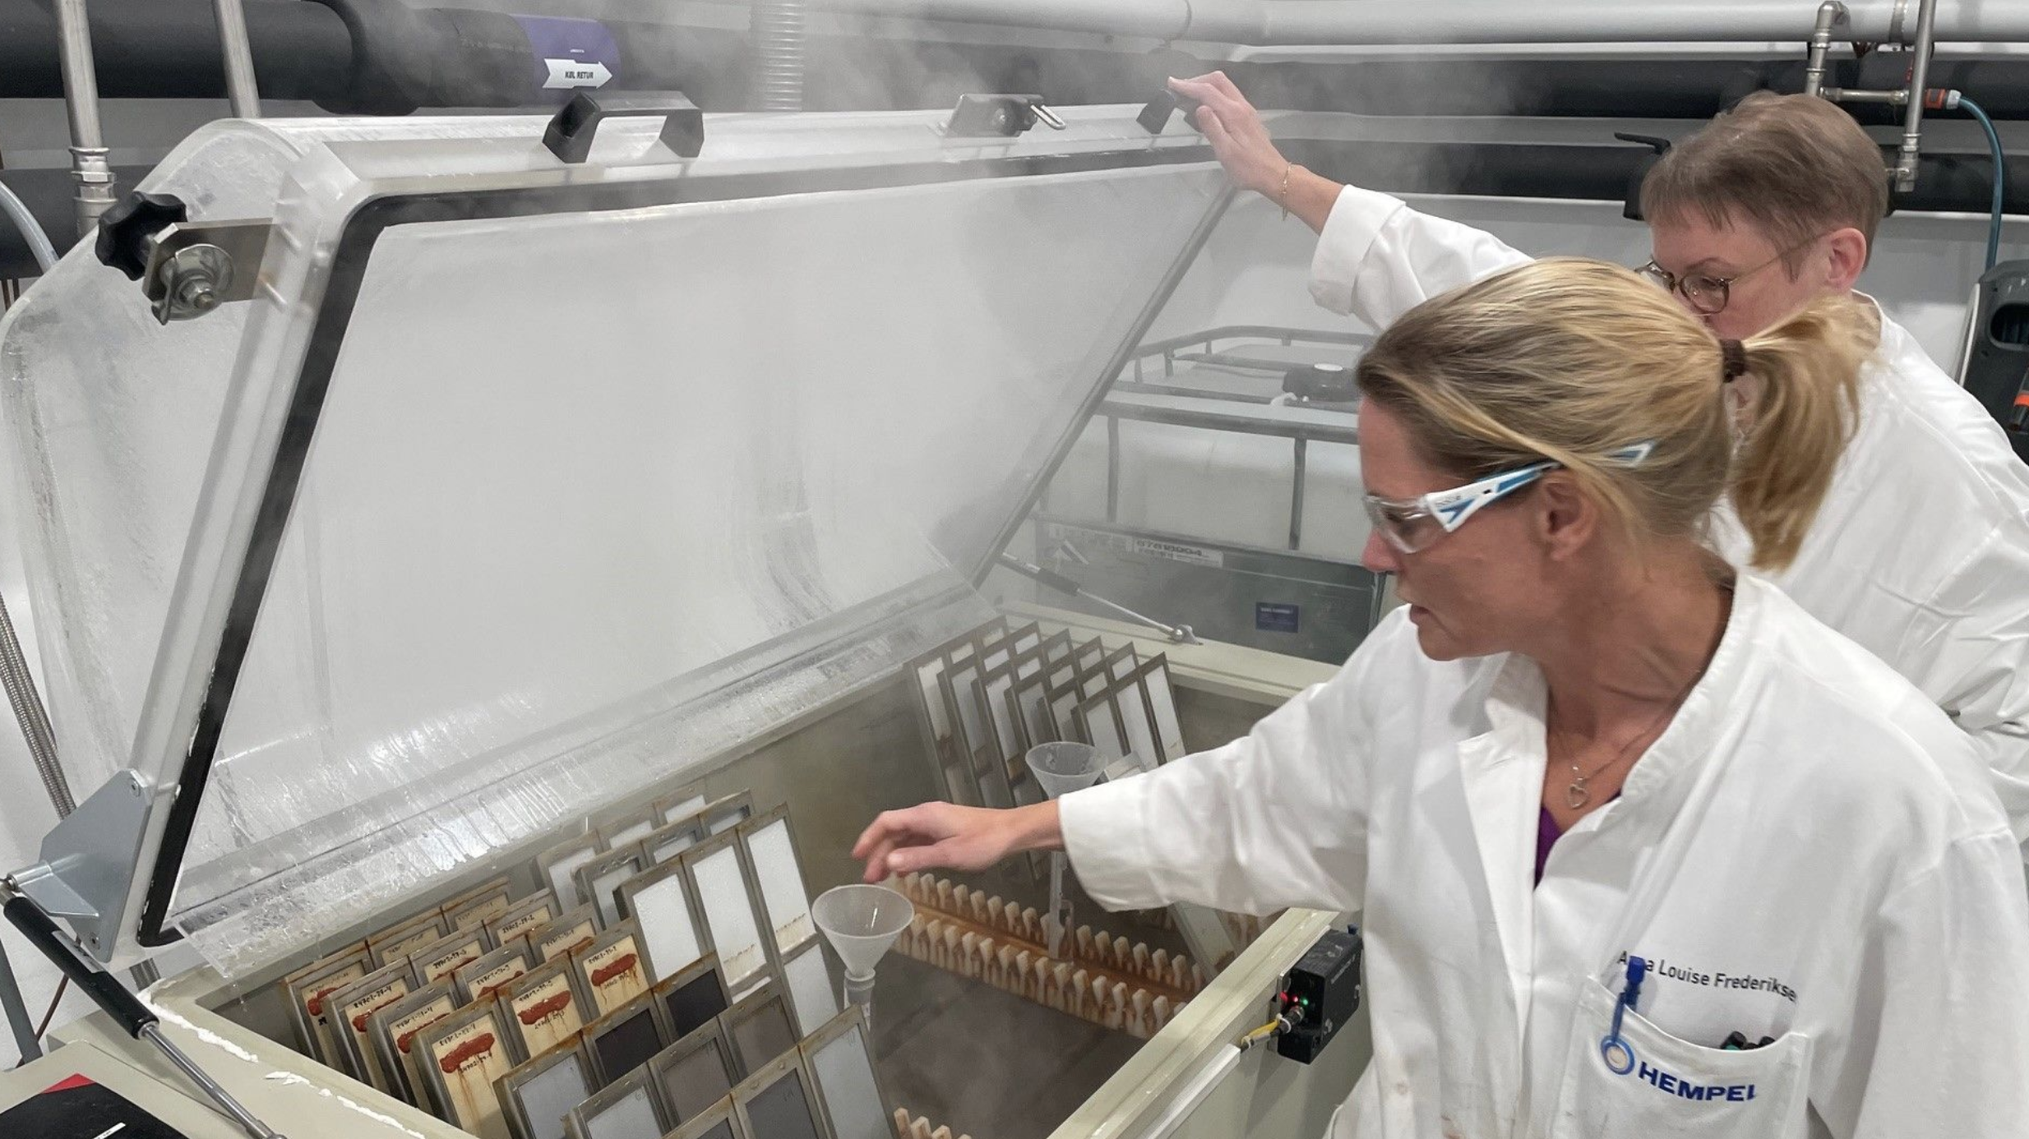
Anna Louise Frederiksen and Helle Fiedler in the Hempel R&D Lab

Slide 3
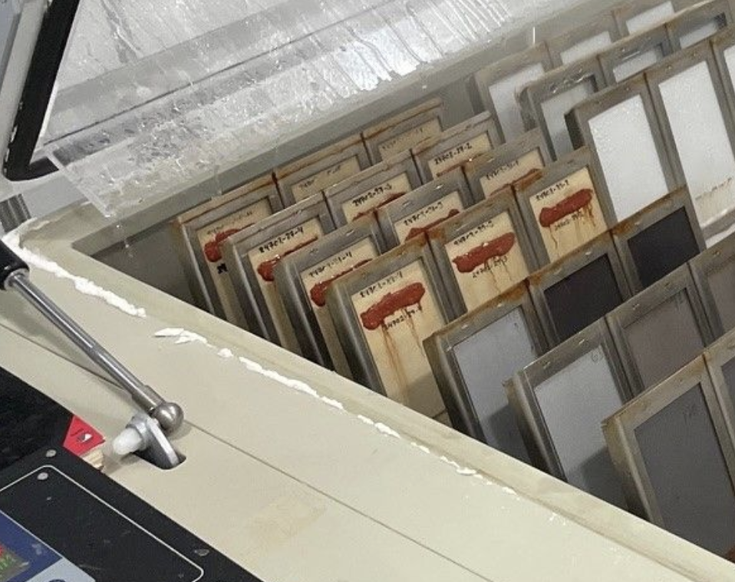
Hempel’s Salt Spray Testing (SST) of its Protective Coatings

Slide 4
Helle Fiedler has been awarded a prestigious US Patent for epoxy coating’s R&D

Slide 5
