Slide 1
Case Study HOW TCO EVALUATION CAN SUPPORT SUSTAINABLE DEVELOPMENT OF IRON ORE TAILINGS
Job Kruyswijk, Slurry Solutions Manager
Weir

Slide 2
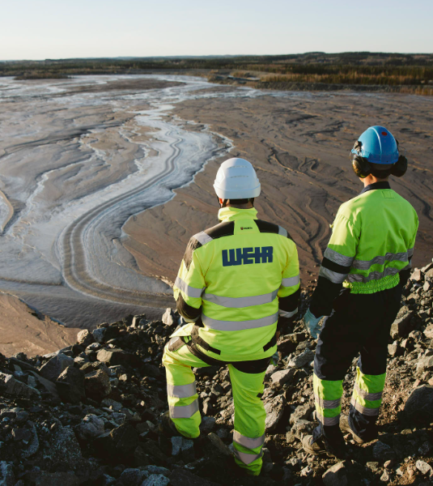
INTRODUCTION
SUSTAINABLE TAILINGS MANAGEMENT
Global tailings output: mining generates 19 billion cubic meters yearly.
Tailings management is a crucial issue after the Tailings Storage Facilities (TSFs) disasters.
Preferred storage: focus on water conservation, stability, and low emissions.
MINING INDUSTRY TRANSITION
Industry commitments:
Net Zero emissions and water usage by 2050.
Ensuring stable, non-failing TSFs for a sustainable License to Operate.
SUSTAINABLE TAILINGS MANAGEMENT
NET ZERO EMISSIONS
LONG-TERM TSF STABILITY
WATER CONSERVATION

Slide 3
CASE STUDY: INTRODUCTION
OBJECTIVE
This case study aims to assess utility costs (water, power) and feasibility of capital investment for sustainable tailings handling, prioritising economic viability aligned with global sustainability goals. The focus is on emissions related to the tailings handling flow sheet.
METHODOLOGY
TCO-based assessment showed a 9-year payback period, deemed unfavourable.
New approach considered future-proofing against carbon tax by upgrading pumping technology.
Methodology: model current and upgraded scenarios, assess capital costs, evaluate differences in power and water consumption.
Also assess reduction in power and water costs, potential carbon tax reduction.
Sensitivity analysis on payback period for variations in carbon tax, power, and water costs.

Slide 4
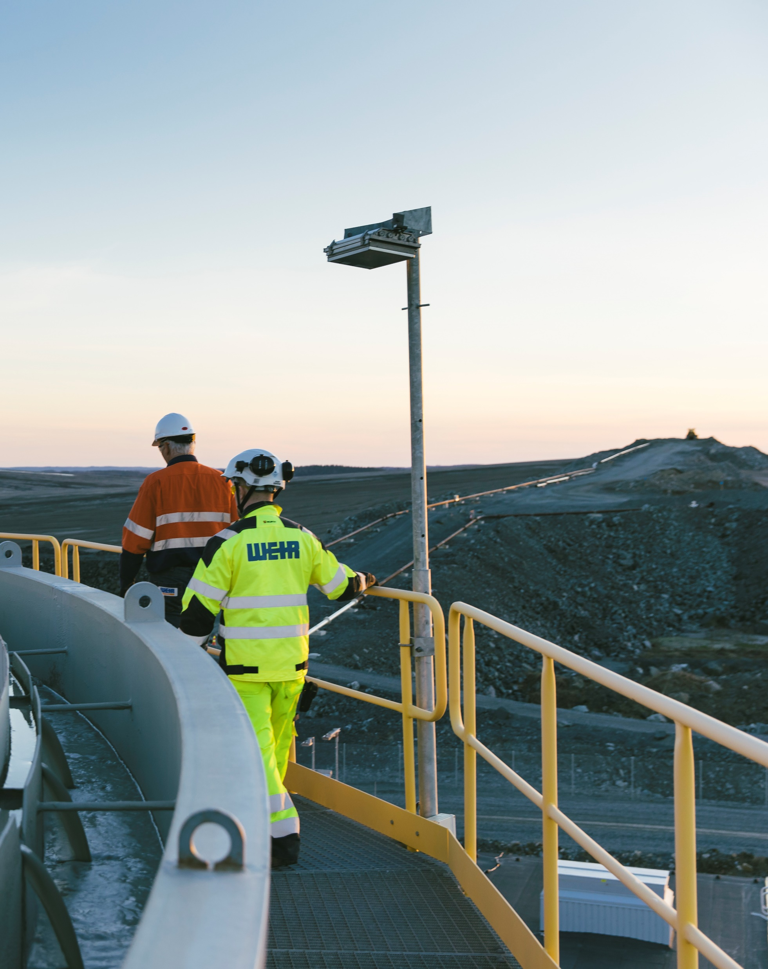
CASE STUDY: BACKGROUND AND ALTERNATIVES
BACKGROUND
Iron ore mining operation in Northern United States with decades of operation.
Tailings Storage Facility (TSF) located 12.5 km from processing plant.
Dilute fine tailings thickened to 32% solids concentration and pumped to TSF via single pipeline.
Pipeline equipped with two pump stations, each with centrifugal pump trains (three pumps in series for first station, four for second).
Pumping strategy under review due to reaching maximum capacity.
TWO ALTERNATIVE SOLUTIONS ASSESSED:
1. Pumping technology upgrade:
Replacing the two centrifugal pumpstations with a single PD pump station.
2. Pumping technology & dewatering upgrade:
Replacing the centrifugal pump stations with a single PD pump station combined with improving tailings dewatering (increase slurry density).

Slide 5
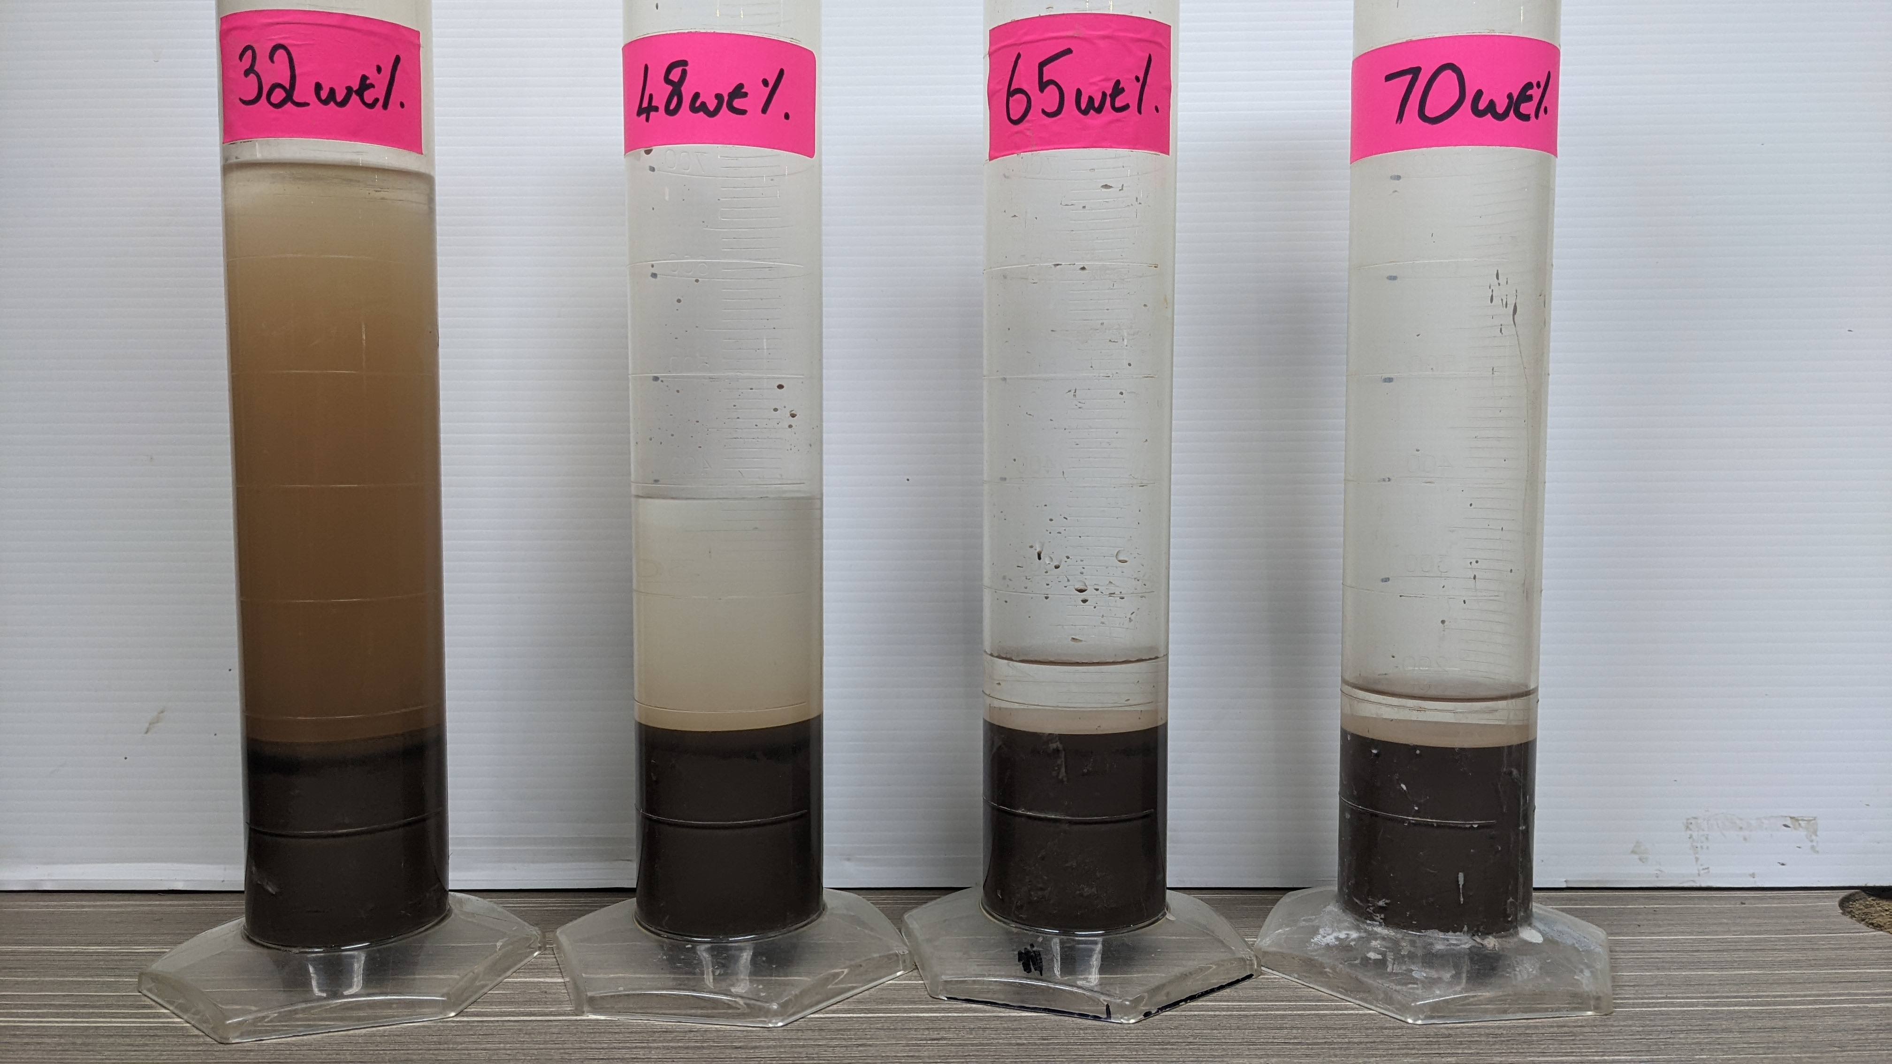
CASE STUDY: PUMP DUTY, MASS BALANCE AND FLOW RATE
PUMP DUTY
Pumping Scenario | C_{w} | Pump station |  | Total pressure /pipeline | Raise
 |  | PS 1 | PS 2 |  | PS 1
Centrifugal - Current | 32% | 21 bar | 48 bar | 69 bar | NA
PD - 1 PS | 32% | 60 bar |  | 60 bar | 63 bar
PD - 1 PS - dewatered | 65% | 63 bar |  | 63 bar | 67 bar
MASS BALANCE AND FLOWRATE
The processing plant produces 2.5 million tons of dry solids per annum.
Currently, the tailings are placed at a solids concentration of 32% by weight.
 | Current | PD | PD + Dewatering
Solids throughput | 969 t/h | 969 t/h | 969 t/h
Slurry Density (S_{m}) | 1.270 t/m³ | 1.270 t/m³ | 1.787 t/m³
Solids Concentration (C_{w}) | 32% | 32% | 65%
Volumetric throughput (Q) | 2,384 m³/h | 2,384 m³/h | 834 m³/h

Slide 6
TAILINGS SYSTEM: CURRENT SET UP VS UPGRADES
CURRENT SET UP - C_{W} 32%
SINGLE PIPELINE
2 PUMP STATIONS
UPGRADES – C_{W} 32% AND C_{W} 65%
Replacing the two centrifugal pumpstations with a single PD pump station
Replacing the centrifugal pump stations with a single PD pump station combined with improving tailings dewatering (increase slurry density).

Slide 7
WATER CONSERVATION
WHAT DOES A CUBIC METER OF FRESHWATER INTAKE COST?
In areas with seasonal wet climates, water is commonly considered a nearly free commodity. Is this a valid assumption?
The total cost of water intake is the sum of direct and indirect costs
DIRECT COSTS
Pumping & filtration of pond or lake water
Water rights
INDIRECT COSTS
Ground water treatment as remediation of seepage induced contamination of aquifers.
Water purchases
Seepage control measures like liners, drains and treatment systems.

Slide 8
WATER CONSERVATION
The thickening of tailings enhances water reclamation by 37%.
Decreasing water pumped to the TSF mitigates undesired water release into the environment via seepage and evaporation.
This reduction correlates with the decrease in surface area covered by the pond.

Slide 9
ABSORBED POWER & CO₂ EMISSIONS
The generation of electricity produces emissions.
The increased efficiency of the PD pumps can reduce emissions by up to 57%.
UP TO 60% REDUCTION
 | Current | PD | PD + Dewatering
Pumping | 6,529 kWh | 4,829 kWh | 1,764 kWh
Thickening | 969 kWh | 969 kWh | 1,454 kWh
Total absorbed power | 7,498 kWh | 5,798 kWh | 3,218 kWh

Slide 10
ASSUMPTIONS
POWER CONSUMPTION
WATER BALANCE
CARBON TAX
Significant electrical power consumption occurs during the pumping and dewatering processes of tailings.
For pumping, power consumption is determined by factors such as pump selection, installed power, and pump efficiency.
Regarding dewatering, power consumption is evaluated using empirical data, sourced from both Weir and Andritz.
Fresh process water is drawn from the TSF pond.
As shown in the previous slides, the cost of water can be determined by a complex set of conditions.
The study assumes a conservative value of US$1.00 per m³ for water. However, the actual value is expected to be higher.
In this study, it is assumed that the industrial operation is charged US$30.00 per ton of CO₂ emitted.
ESG UNIT COSTS
Water | US$1.00 per m³
Power | US$0.10 per kWh
Carbon tax | US$30.00 per ton

Slide 11
OPERATIONAL COSTS
The proposed replacement of the current pumping system with a more efficient single pump station PD solution minimally impacts operational expenses.
A comprehensive upgrade of the tailings handling system yields a notable decrease in operational costs.
The reduction in freshwater intake and absorbed power demonstrates a proportional relationship.
*Cost estimate +/- 30%
Cost estimate based on operational experience.
Power costs based on absorbed power for tailings dewatering and pumping.
Fresh water intake water costs estimated for typical operations.

Slide 12
CAPITAL COSTS AND PAYBACK
The upgrade of the tailings pumping system entails a substantial capital investment. While upgrading the pumps does not decrease the total flow, it necessitates the operation of four pumps.
However, by increasing the slurry density, the number of pumps required reduces to two. In this scenario, it is necessary to consider upgrading or replacing the current thickeners.
CAPEX | PD – C_{w} 32% | PD – C_{w} 65%
Pump configuration | 4 + 1 | 2 + 1
Total CAPEX* | Circa US$20M | Circa US$50M
PAYBACK
In the first scenario, despite optimised pumping efficiency, the payback period is approximately 8 years.
However, due to lower operational costs in the second scenario, the payback period is reduced to approximately 5 years.

Slide 13
SENSITIVITY
IMPACT OF COSTS VARIATIONS
Enhanced water recovery significantly boosts investment break-even, especially if water's future value rises.
Rising power costs rank second in impact on achieving break-even for upgraded tailings pumping investments.
Contrary to common belief, carbon taxes or levies have minimal influence on the feasibility of sustainable investments.

Slide 14
CONCLUSIONS
KEY CONCLUSIONS:
Upgrading the pumping technology reduces absorbed power and emissions.
Increasing the solids concentration of the tailings maximises pumping efficiency, thereby decreasing absorbed power and emissions.
Conventional tailings deposition is most sensitive to increases in power costs.
Thickened/paste tailings reduce sensitivity to power costs. Projected future water costs have the greatest impact on the feasibility of thickened/paste tailings.
Maximum results in future-proofing tailings handling systems are achieved by an integral approach, upgrading both pumping and dewatering.
Note: Each site will have its own specific tailings characteristics and requirements. A site-specific assessment will identify which solution is best for the specific application.

Slide 15
Questions?
Job.Kruyswijk@mail.weir
Erik.Vlot@mail.weir

Slide 16
Forward-looking statements
This information includes ‘forward-looking statements’. All statements other than statements of historical fact included in this presentation, including, without limitation, those regarding The Weir Group’s (“the Company”) financial position, business strategy, plans (including development plans and objectives relating to the Company’s products and services) and objectives of management for future operations, are forward-looking statements. These statements contain the words “anticipate”, “believe”, “intend”, “estimate”, “expect” and words of similar meaning. Such forward-looking statements involve known and unknown risks, uncertainties and other important factors that could cause the actual results, performance or achievements of the Company to be materially different from future results, performance or achievements expressed or implied by such forward-looking statements. Such forward-looking statements are based on numerous assumptions regarding the Company’s present and future business strategies and the environment in which the Company will operate in the future. These forward-looking statements speak only as at the date of this document. The Company expressly disclaims any obligation or undertaking to disseminate any updates or revisions to any forward-looking statements contained herein to reflect any change in the Company’s expectations with regard thereto or any change in events, conditions or circumstances on which any such statement is based. Past business and financial performance cannot be relied on as an indication of future performance.
Copyright and confidential information
This document contains information which is protected by copyright and is confidential to companies forming The Weir Group PLC. It should not be disclosed, in whole or in part, to parties other than the current recipient without the express written permission of an authorised person employed by The Weir Group PLC.

