Slide 1


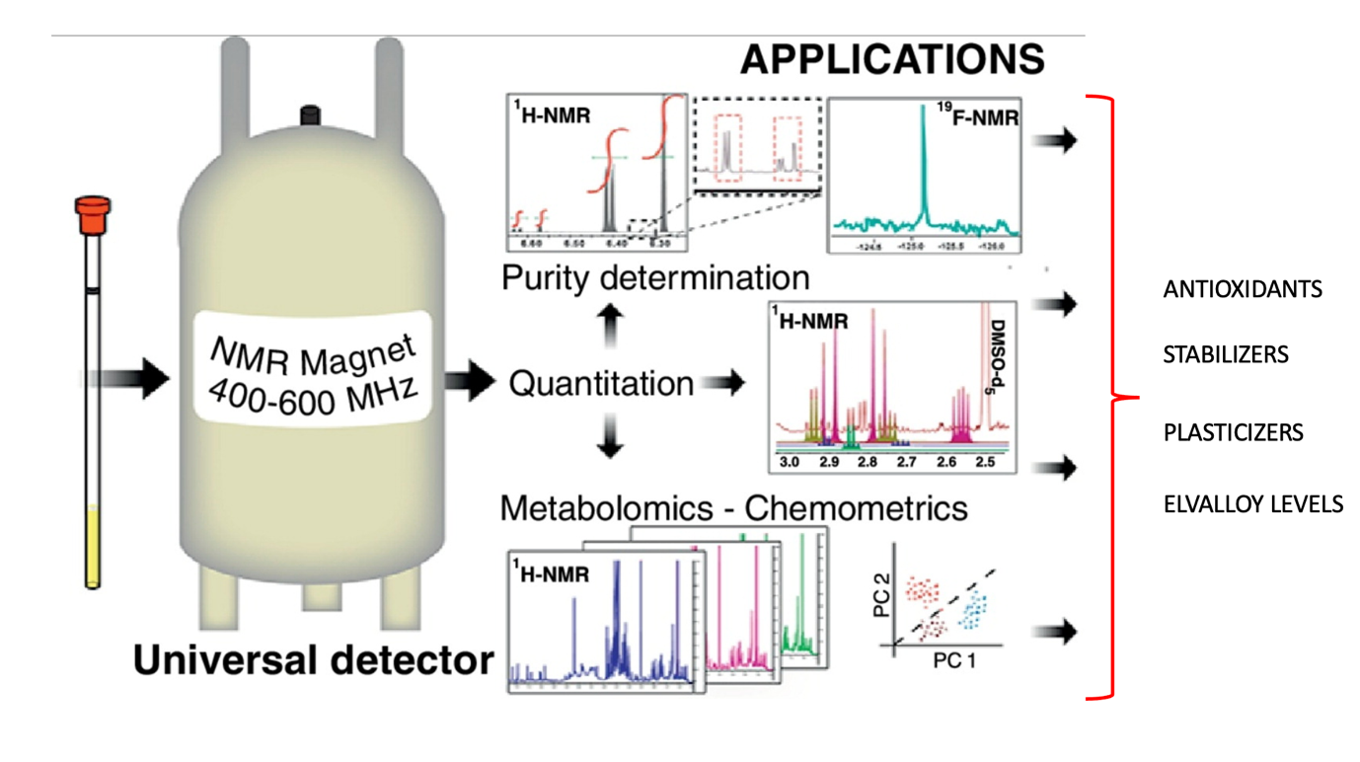
Leveraging NMR for Deformulation and Durability Assessment of Geosynthetic Materials
Dr Frank Bambino and Dr John Scheirs

Slide 2
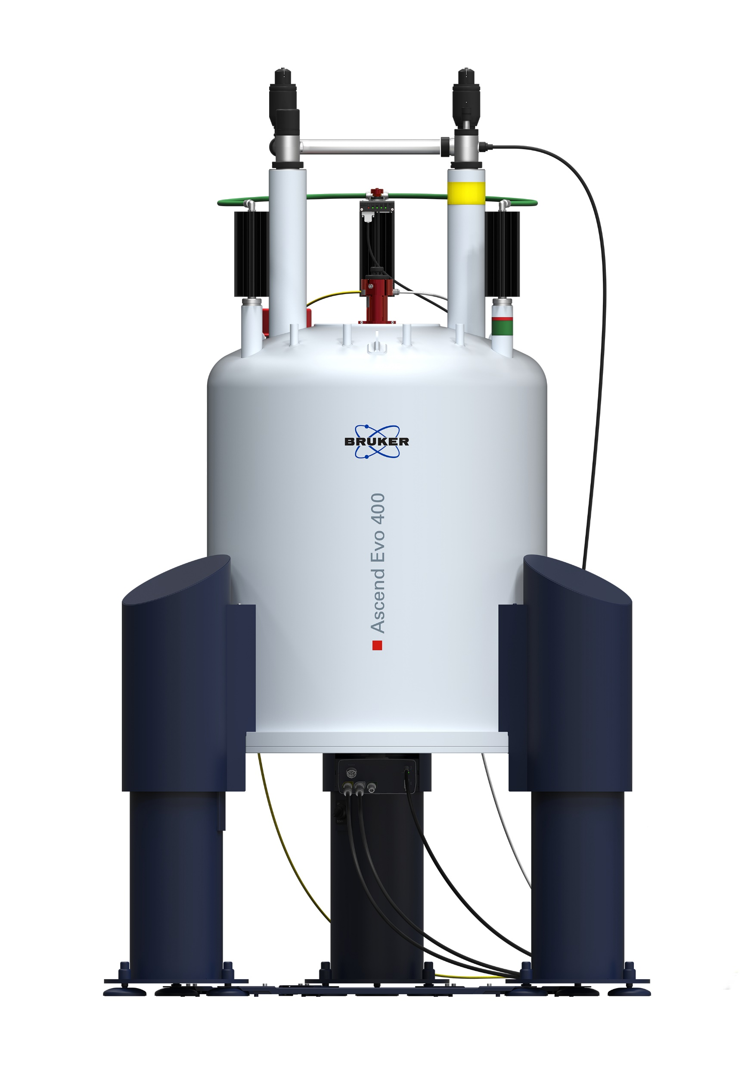
Proton (hydrogen) NMR is a powerful solution phase spectroscopic technique for the identification and quantification of organic based polymer additives
Proton NMR is essentially a hydrogen atom detector
Signal response is directly proportion to the number of hydrogen atoms
Individual reference standards are not required for quantification of each analyte
All additives can be quantified in a single run
Perfect for the analysis of unknown samples

Slide 3
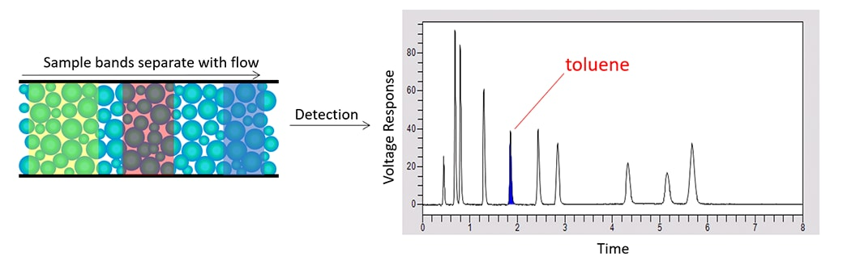
High Performance liquid chromatography
Complementary technique to NMR spectroscopy for the quantification of polymer additives
Used in conjunction with NMR for complex samples enabling full characterization of polymer additives in geosynthetic materials (or any stabilised polymer material)
Polymer additives
HPLC Column with C18 coated silica adsorbent

Slide 4
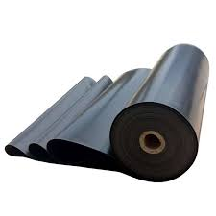
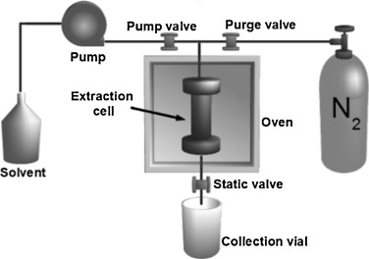
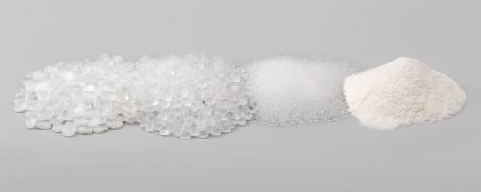
Accelerated Solvent Extraction (ASE)
Polymer sample is exhaustively extracted with solvent to remove the additives
The isolated additives are dissolved prior to analysis

Slide 5
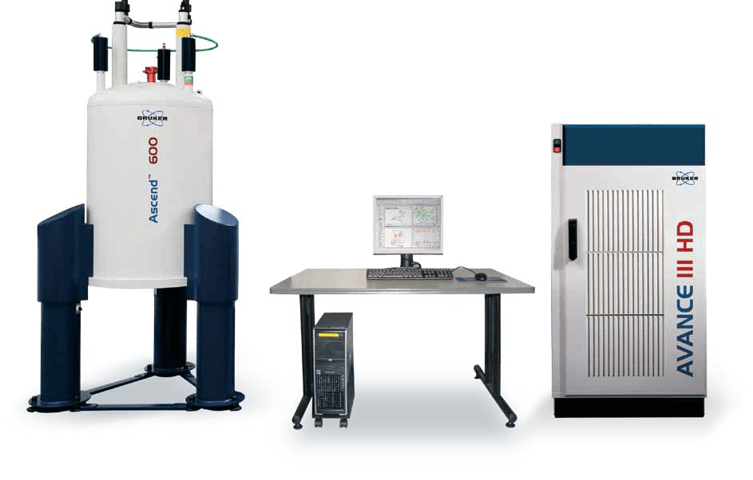
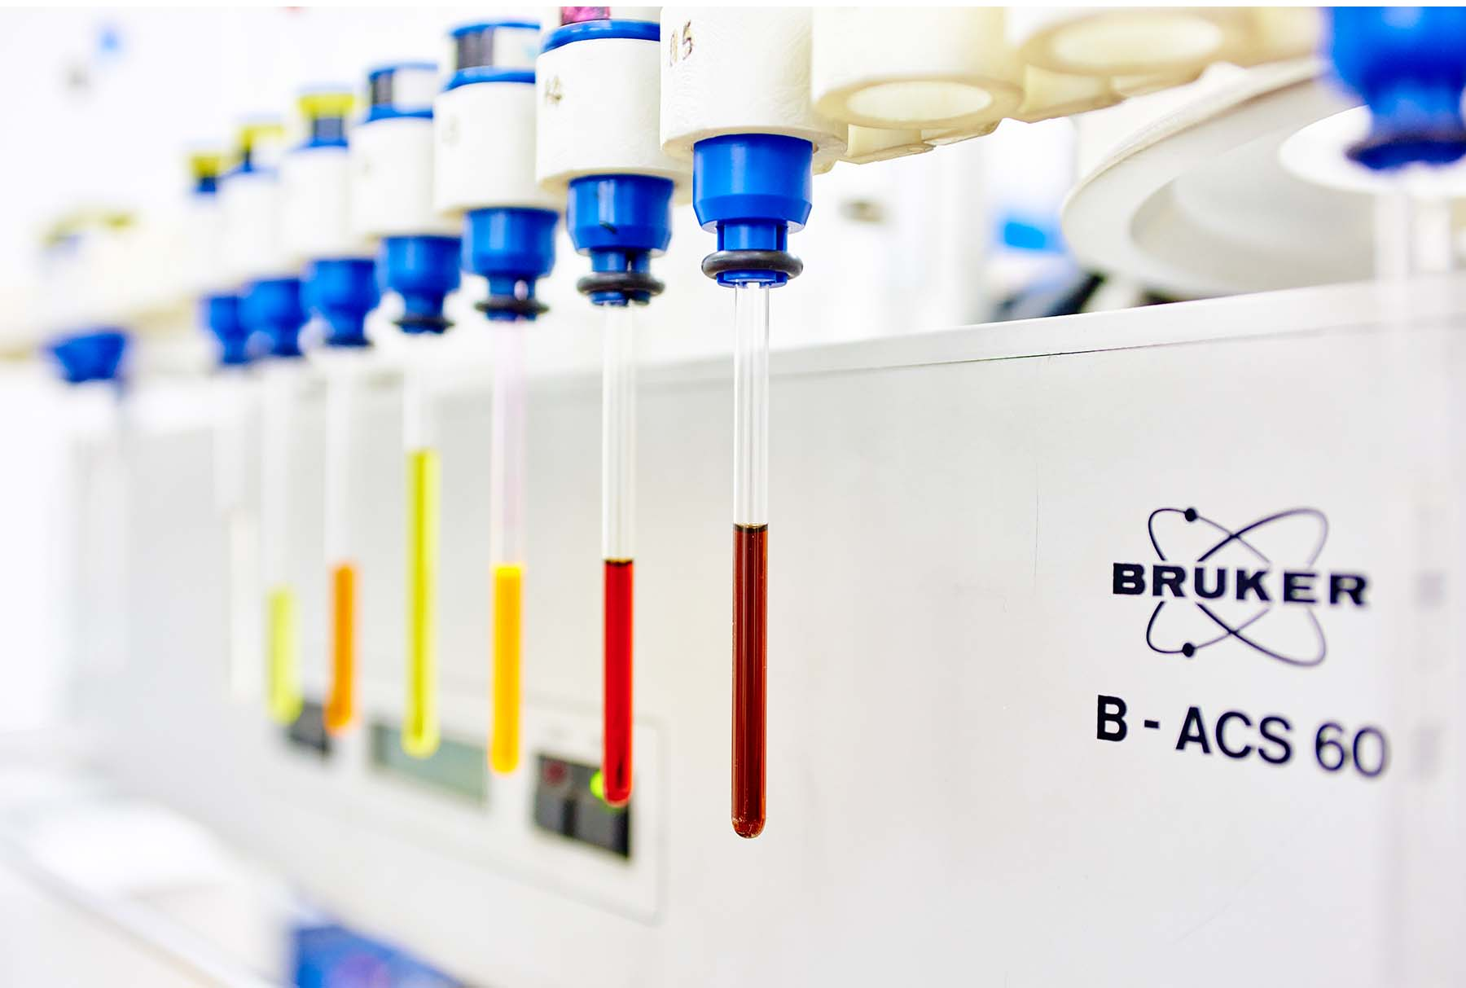
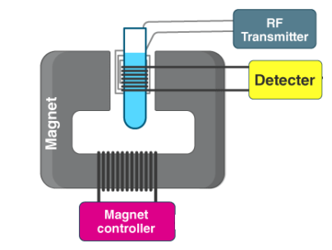
NMR spectrometer
Superconducting magnet 600MHz (14 Tesla)
Radio frequency generator and detector
Sample Tubes
The dissolved additives are placed in glass tubes (0.8 mls) and inserted into the magnet bore.

Slide 6
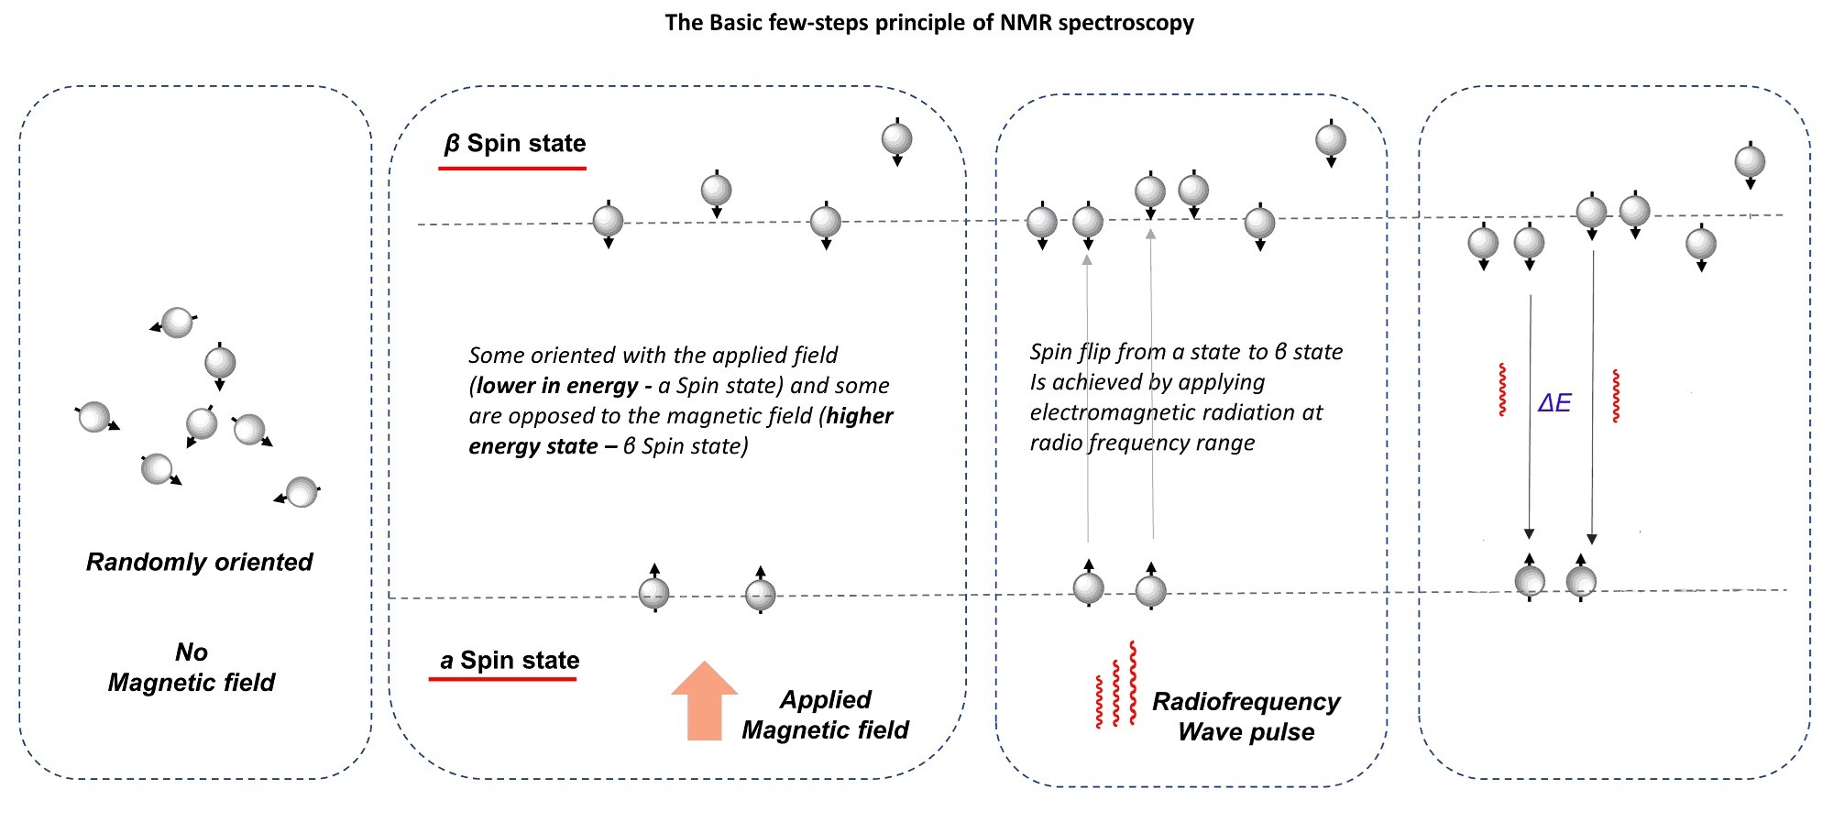
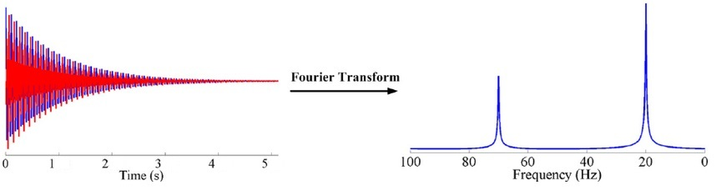
Basic principle of NMR
When spins return to their lower energy state they release RF energy which is detected
The signal detected is called a free induction decay (FID)
NMR spectrum

Slide 7

Typical Proton NMR spectrum of wine
Can you Identify the components and assign the peaks?
Intensity
4621.8
300
201.4
Chemical Shift (ppm)

Slide 8
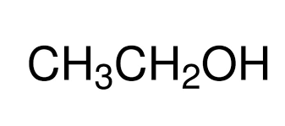
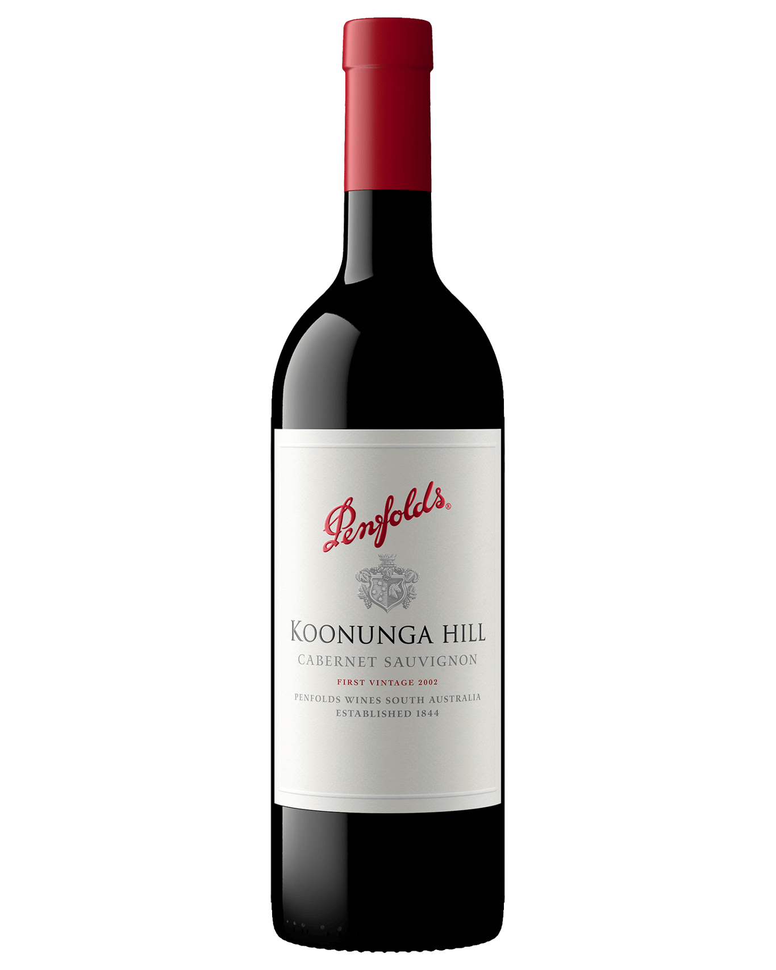
Proton NMR spectrum of wine
Water
H₂O
Ethanol
4621.8
300
Wine is mainly ethanol and water
2H from water
1H from ethanol
201.4
3H
2H
NMR spectrum

Slide 9
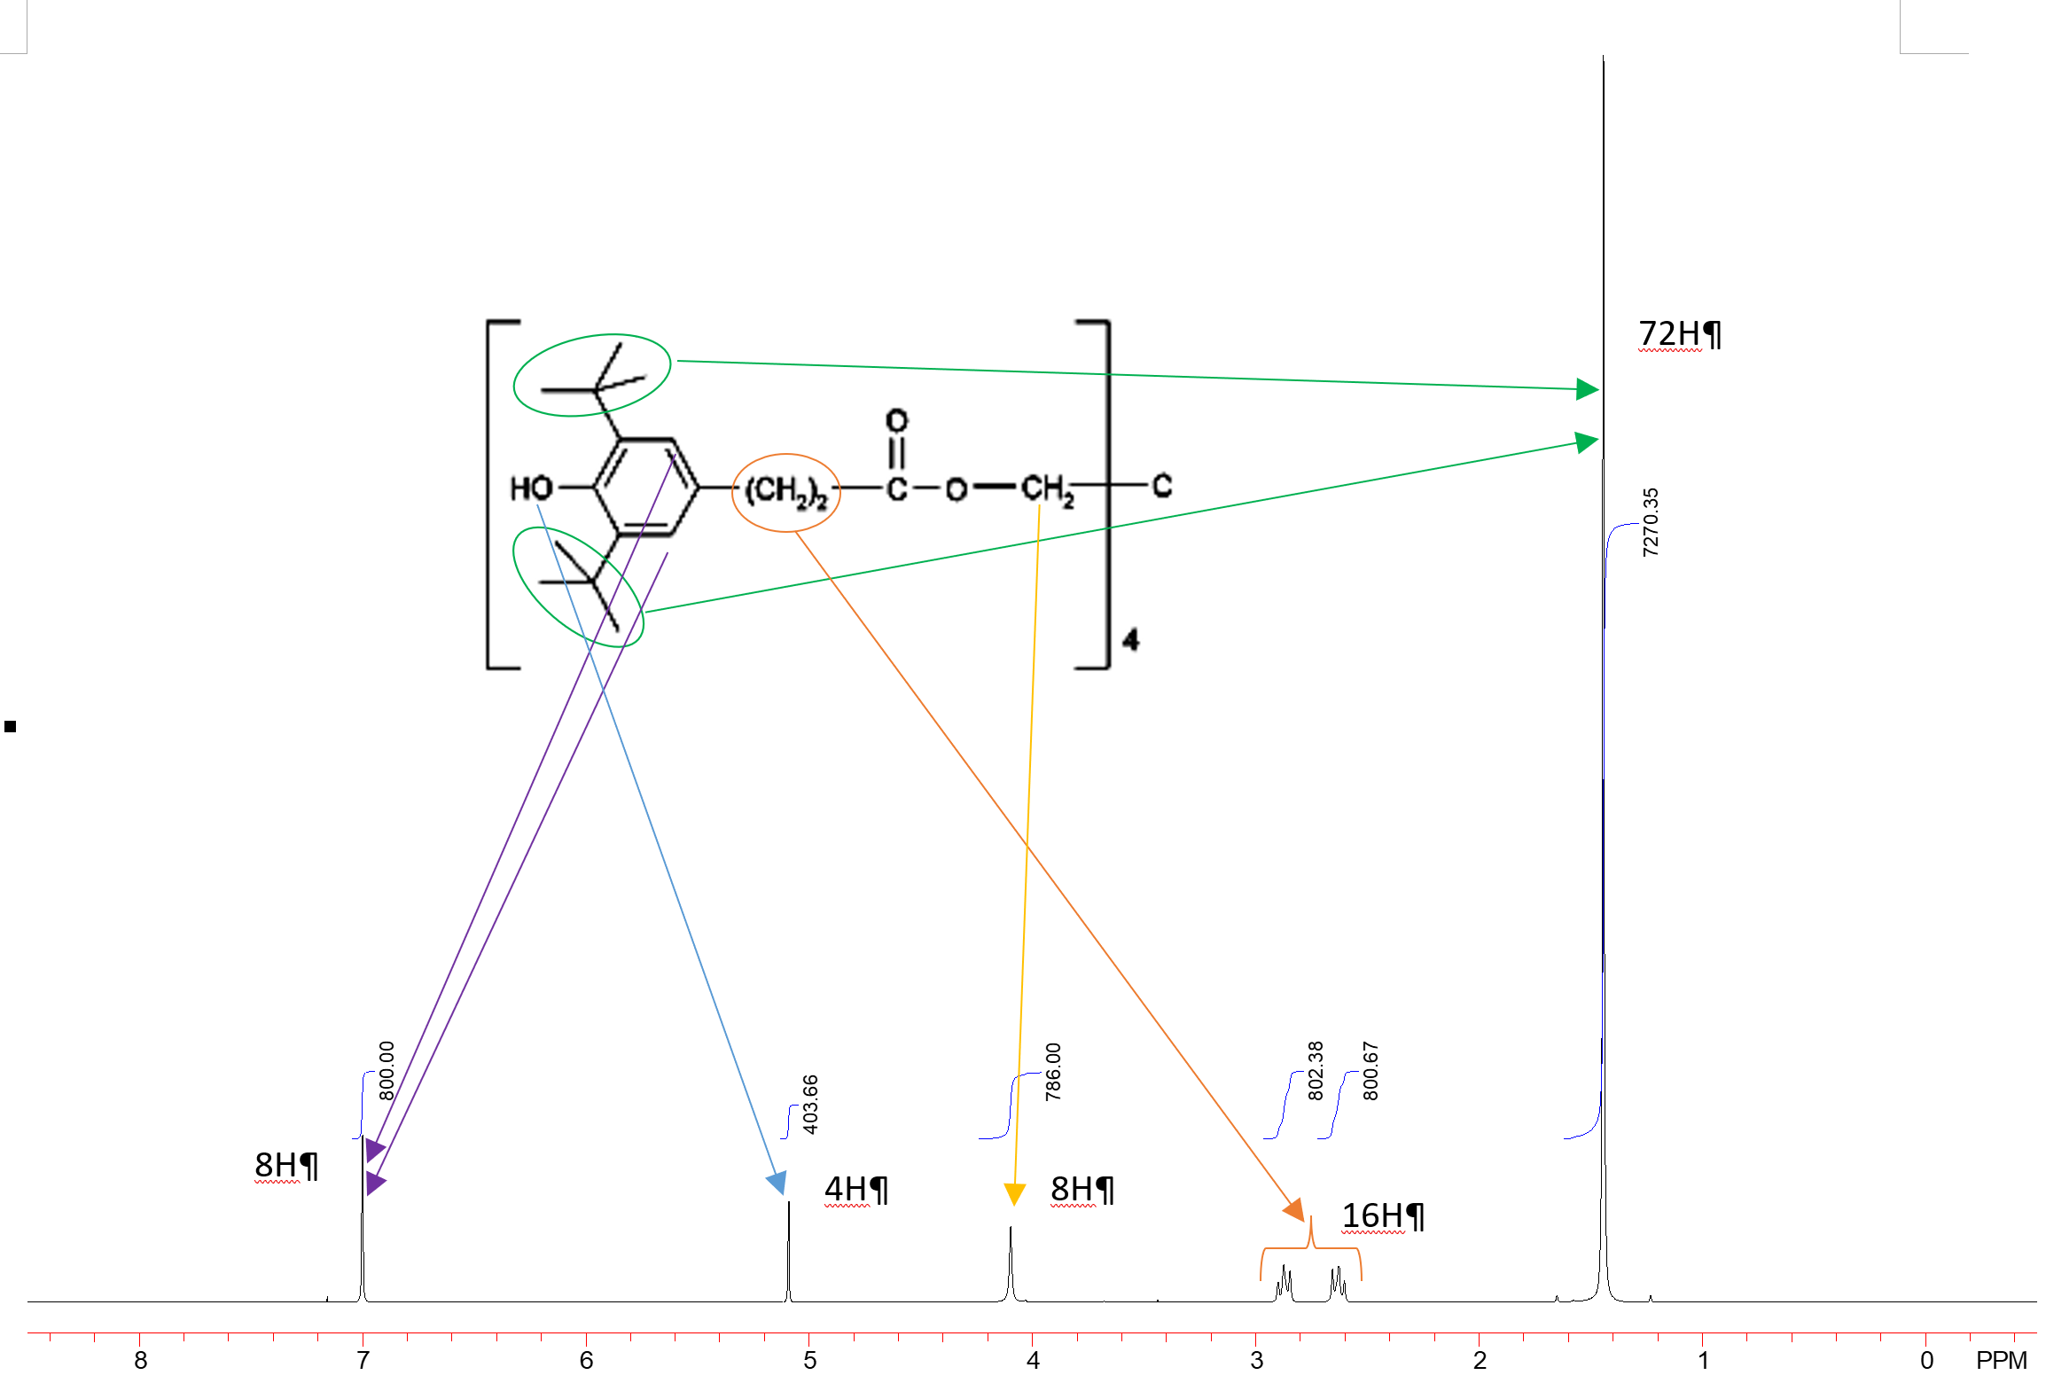
Proton NMR spectrum of Irganox 1010

Slide 10
Proton NMR spectrum of Polymer extract
Example polymer extract containing Irgafos 168, Irganox 1010, Irganox MD 1024 and Irganox 1330
Irgafos 168 (oxidized)
MD 1024 Irg 1010 Irg 1330

Slide 11
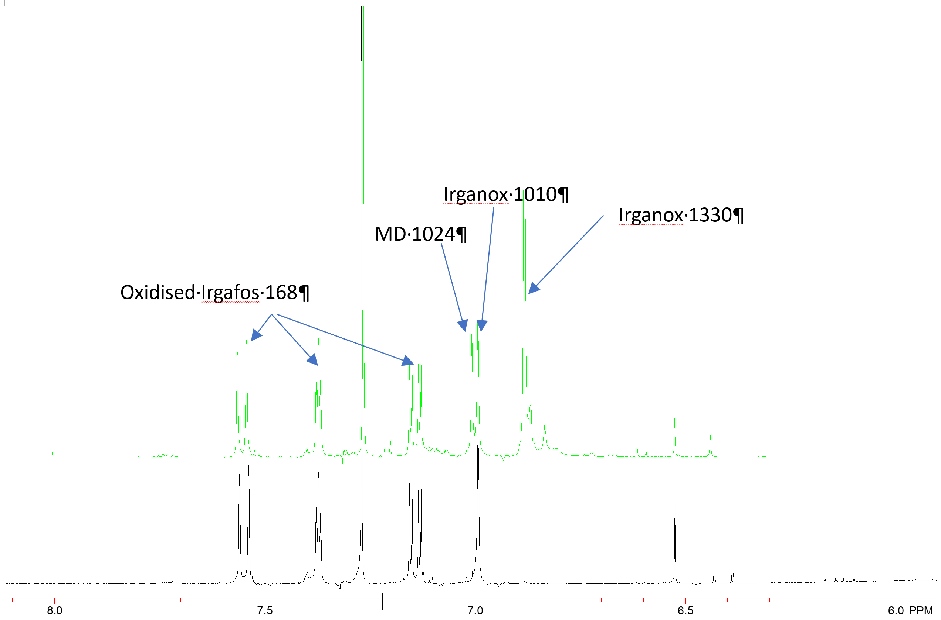
Failure analysis
Good sample
Failed sample

Slide 12

Summary
NMR spectroscopy coupled with HPLC analysis are very powerful techniques for the deformulation of geomembrane materials.
Antioxidants and UV stabilisers can be identified and quantified.
Levels of plasticisers and Elvaloy can be identified and quantified
NMR analysis is well suited to the analysis of unknown additives in geomembrane samples (e.g. competitor analysis)
Troubleshooting in failure analysis
Fin (end)

