Slide 1
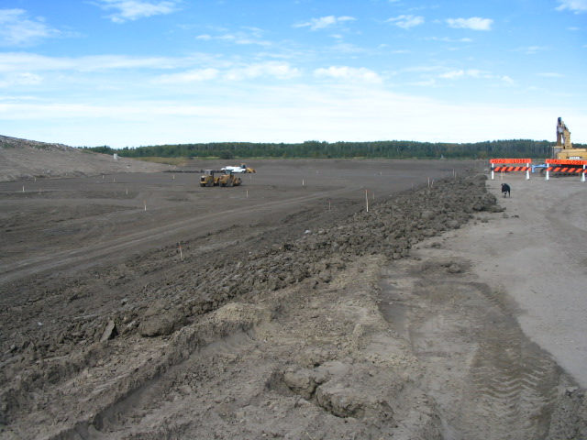
Grande Prairie Landfill Alberta (Canada) using shredded rubber for drainage layer directly on Coletanche

Slide 2
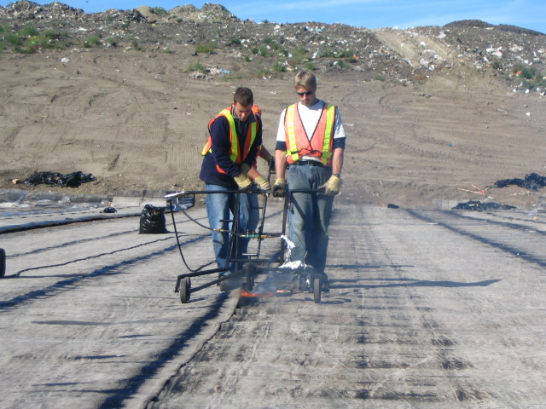
Grande Prairie Landfill Alberta (Canada)

Slide 3
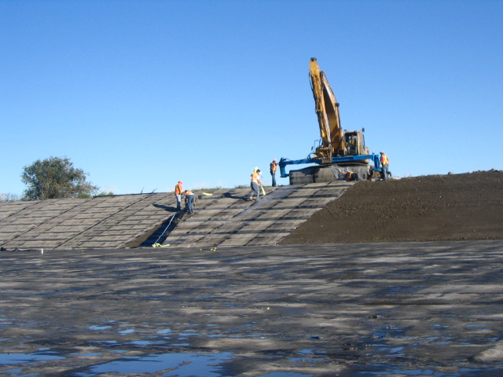
Grande Prairie Landfill Alberta (Canada)

Slide 4
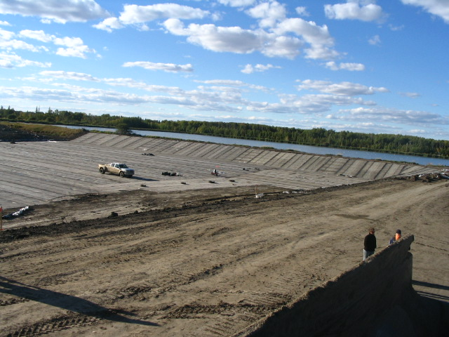

Slide 5
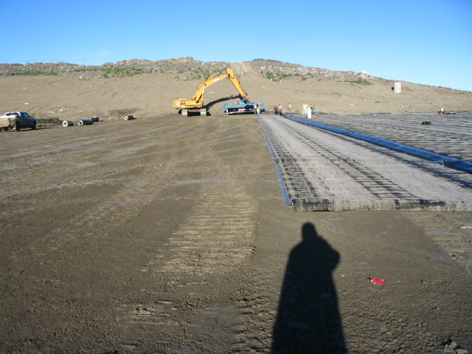
The product staying completely flat with a direct contact on clay layer, no wrinkles, no holes

Slide 6
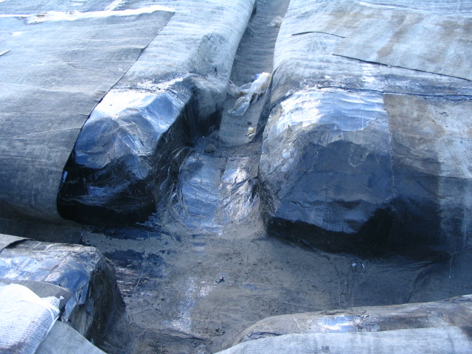
only the flexibility even at cold permit to do this detail and the trench for drainage pipe

Slide 7
